Slide 1

WE INSPIRE WOMEN TO CODE
PINK SUNDAYS
Introduction to Terraform with AWS

Slide 2

Akshata Mongha - a generalist with a broad skill set and a passion for continuous learning.
Looking for a new adventure!
DevOps Specialist
Scrum Master
Data Analyst
Test Manager
Project lead
Scrum Master
TDM Developer & Lead
ETL Developer & Data Mining
Senior Software Engineer
2012
2023
Time

Slide 3
Few guidelines
There is no wrong question
Similarly there is no wrong answer
In case you are stuck or fall behind ask the Code Mentors to help you

Slide 4
Exercise 1
Create aws infrastructure using AWS console

Slide 5
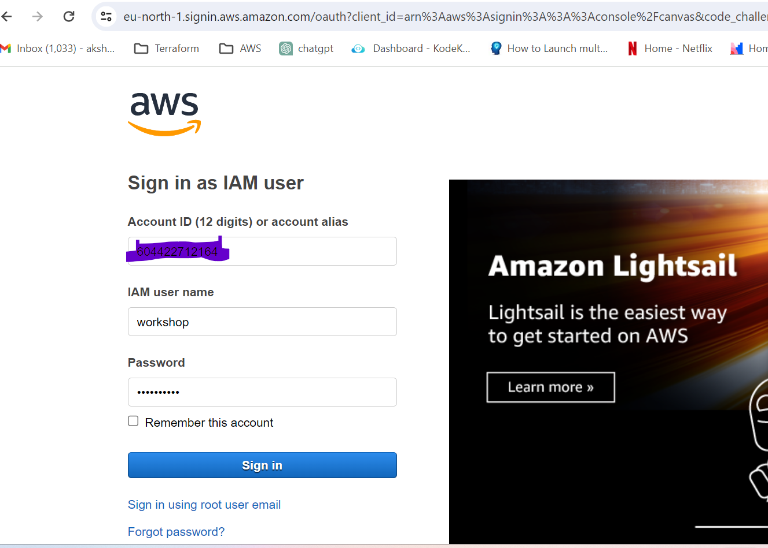
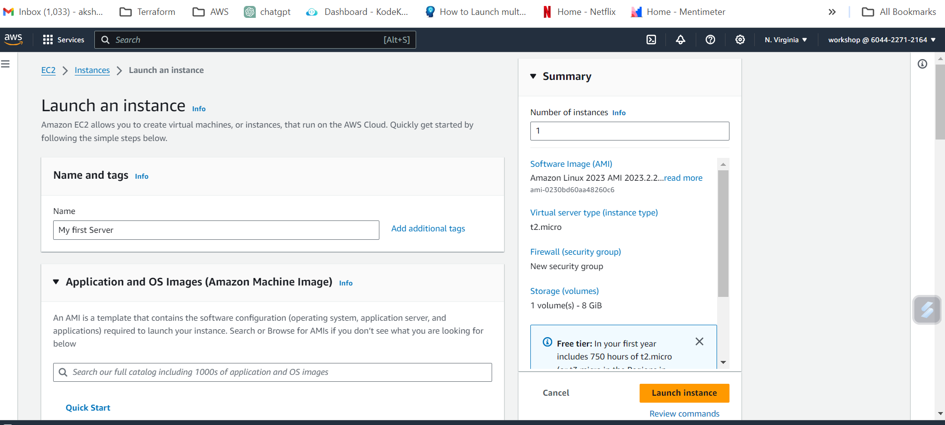
Launch EC2 using console
Login using the URL and credentials you saved as part of Pre-requisite Setup
Select EC2 from services or type
EC2 in the search tab
Select Launch EC2 instance
Choose free tier instance

Slide 6
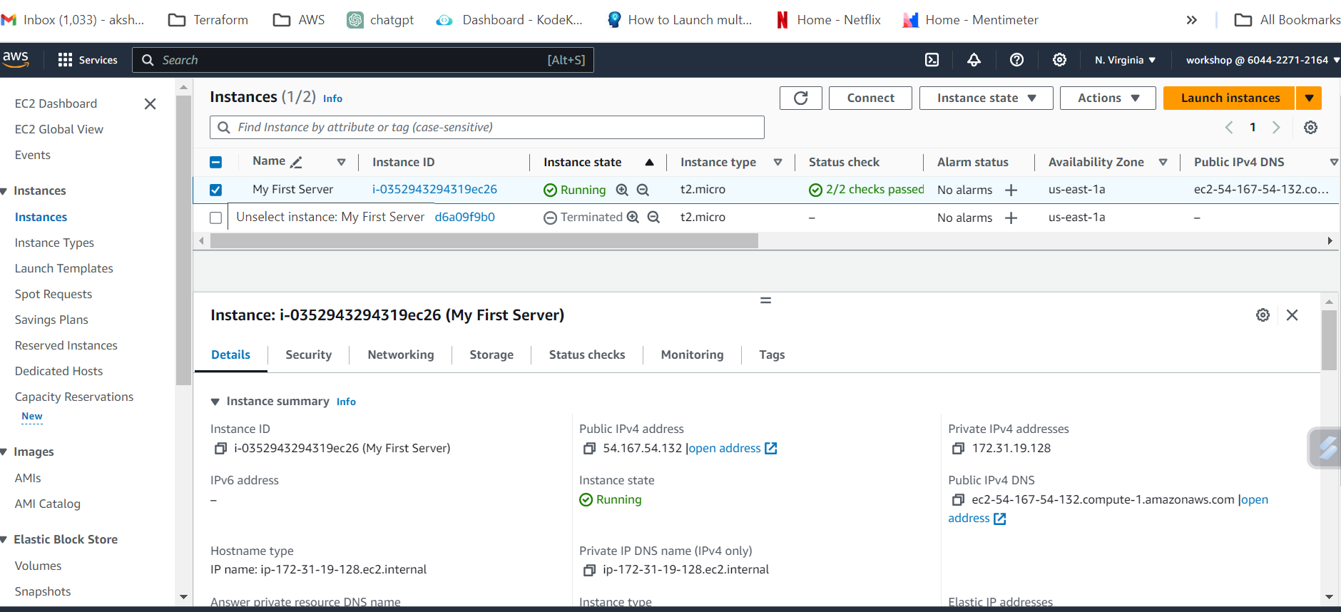
Congratulations on building your first Server on AWS !!

Slide 7

Imagine building infra manually via Console for an entire application or organisation
Use cases:
New infra
Add infra
Delete infra
Upgrade infra
Easy if its automated right? Hence Infrastructure as Code.

Slide 8
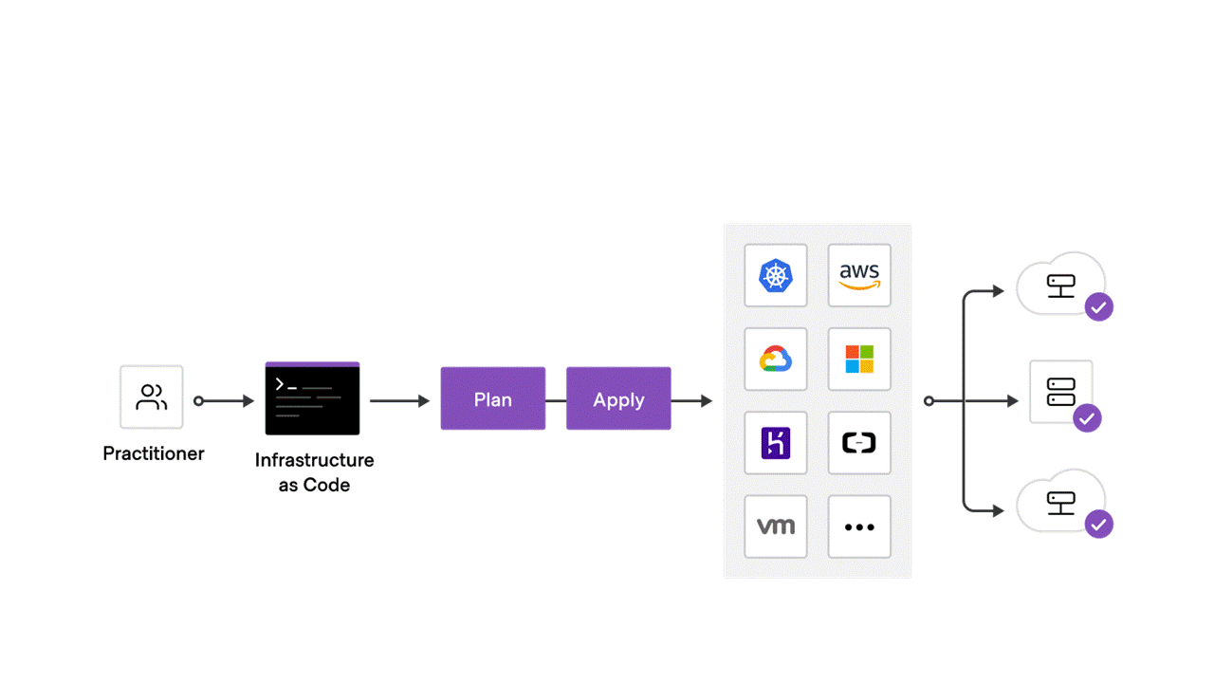
Terraform –HashiCorp’s Infrastructure as code (Iac) tool
Allows you automate and
manage your infrastructure
Its declarative i.e. No need to
bother with how only what
Was Open source until
August 2023
Human-readable configuration
Manage any infrastructure

Slide 9
Exercise 2
Creation of Workspace for the Workshop
Install aws cli
Create keys for aws cli
Configure aws
Install terraform

Slide 10
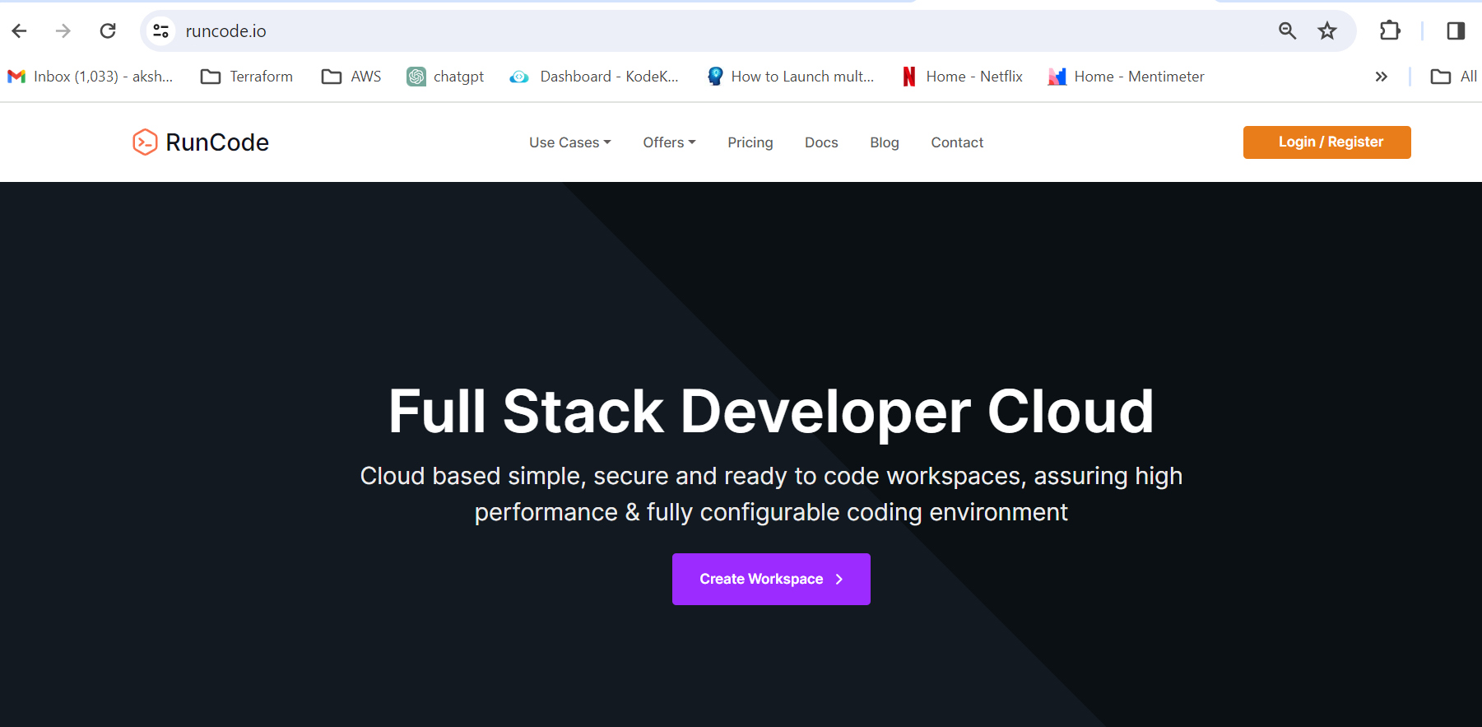
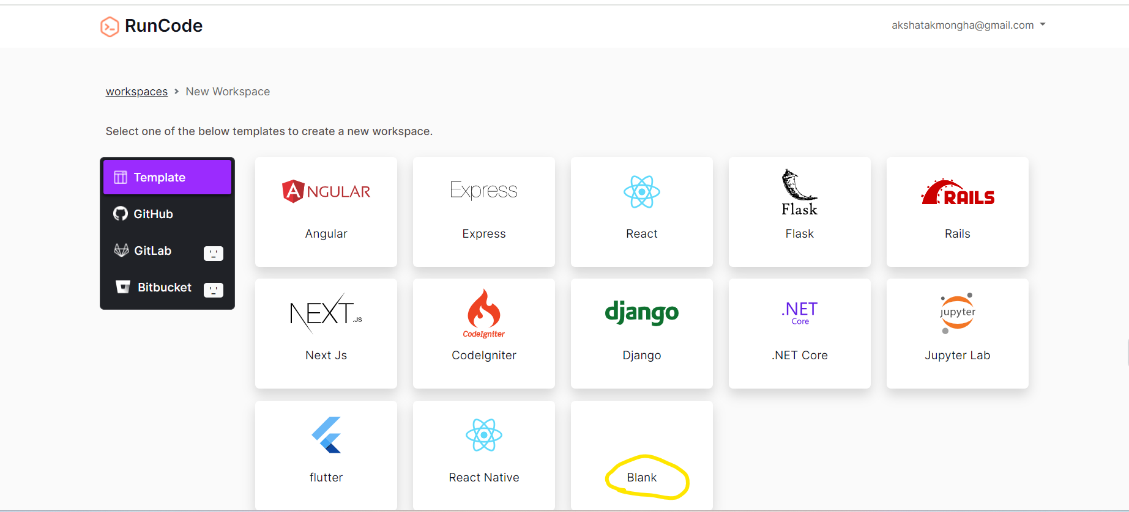
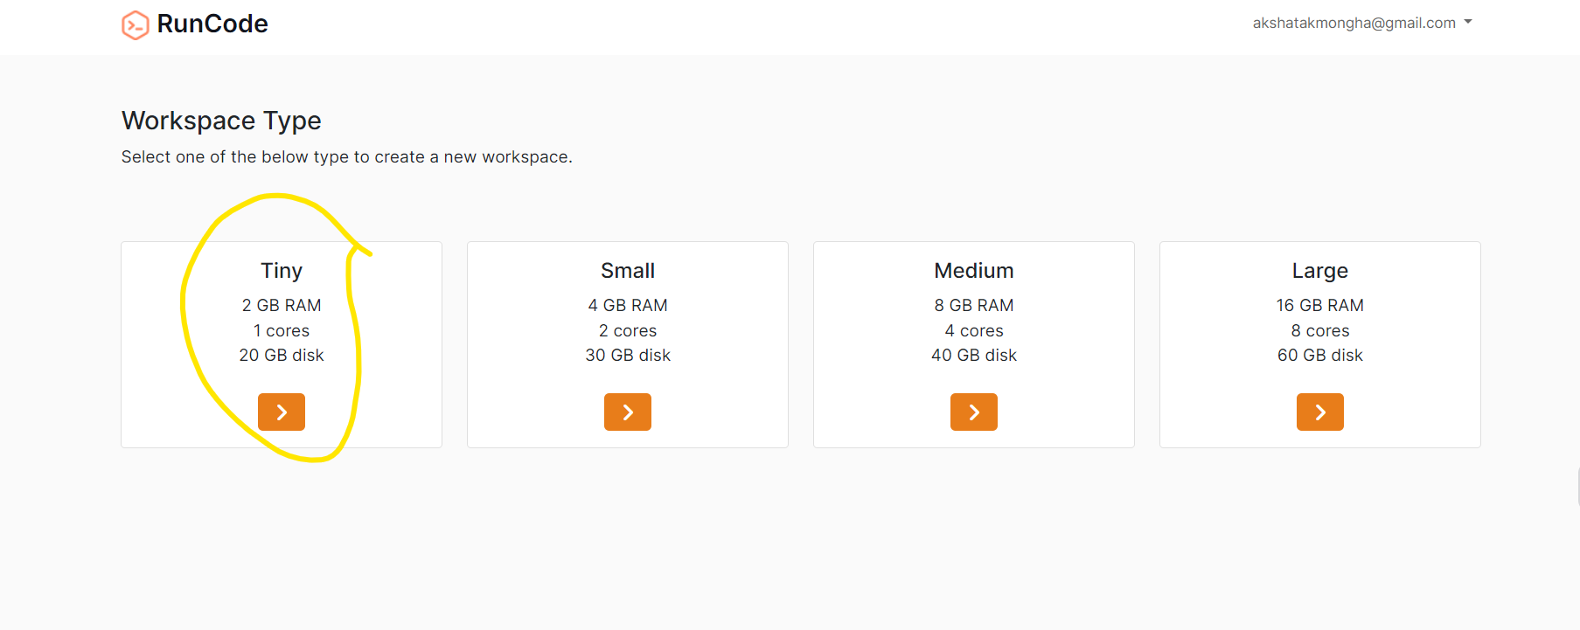
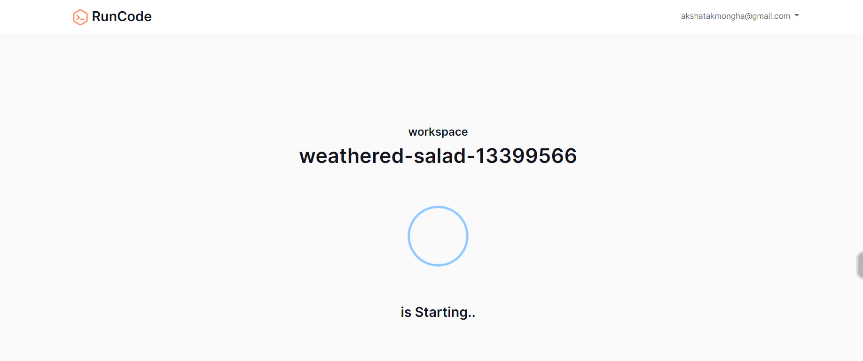
Creation of Workspace
Go to https://runcode.io/ide/team/9hapdaxugdde1yjqijtn/join/
Login with Gmail, Git etc
On the home page select Terraform workshop from drop down
Select the blank Work space on
the template page
Select the Workspace Type as
‘Tiny’
Wait for the workspace to be
started

Slide 11
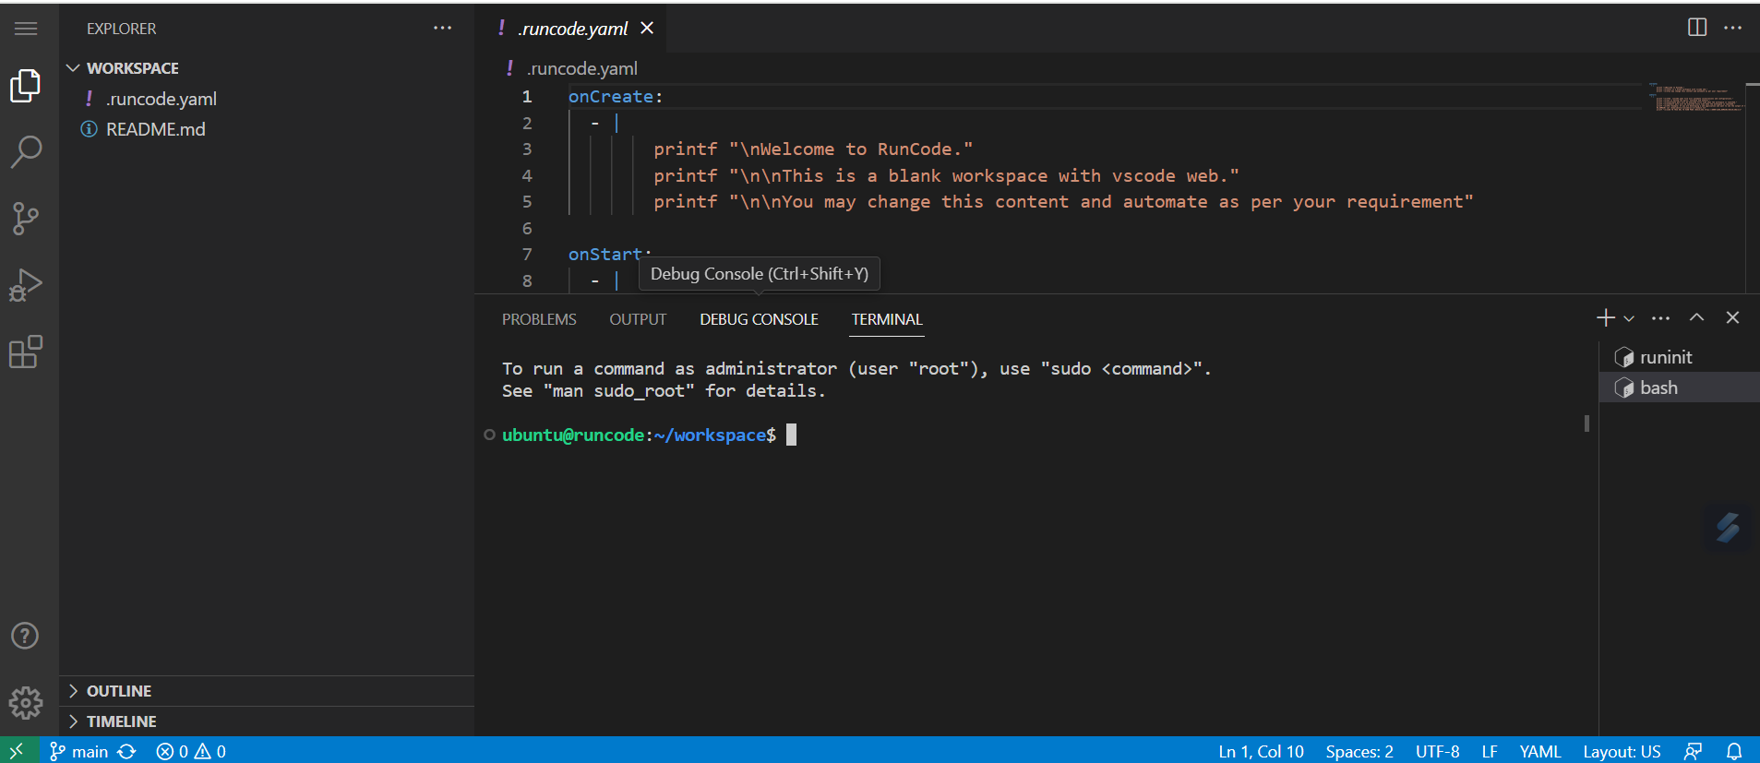
Congratulations your Workspace is ready !!

Slide 12
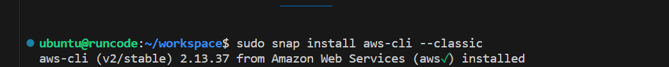
Install AWS command line –aws cli
Run the below command in the terminal
$ sudo snap install aws-cli --classic
Check if aws is installed
$ aws --version

Slide 13
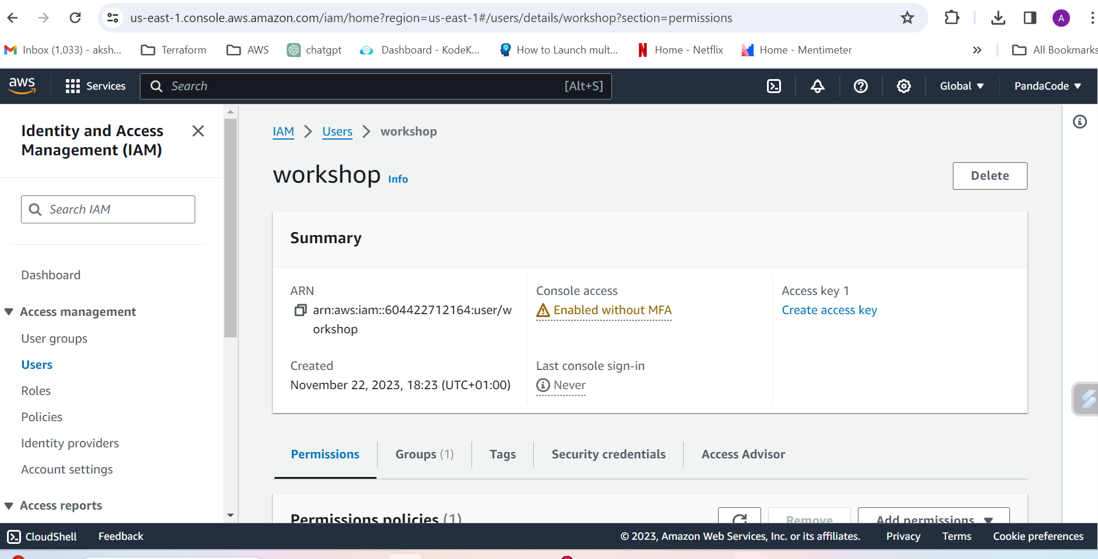
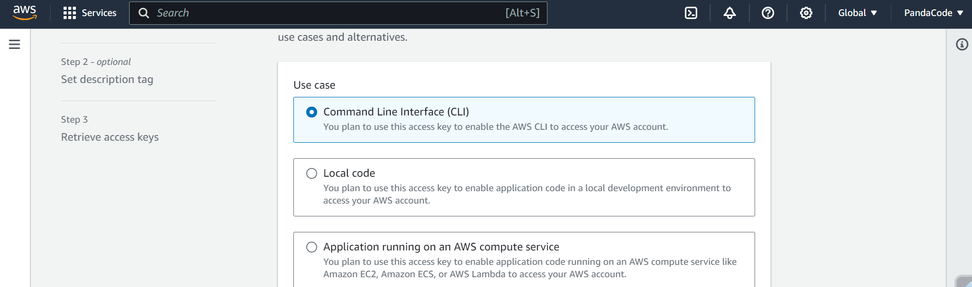
Create keys for aws cli
Login to AWS console
Select the user created as part of the pre-requisite
Select secret key
Select Use case CLI
Save the keys generated

Slide 14
Configure aws
Keep your IAM credentials ready- the one which we created in the earlier step
Lets go back to our Workspace and enter below commands in the terminal
$ export AWS_ACCESS_KEY_ID=
$ export AWS_SECRET_ACCESS_KEY=
By default, these files are located at $HOME/.aws/config and $HOME/.aws/credentials on Linux and macOS, and "%USERPROFILE%\.aws\config" and "%USERPROFILE%\.aws\credentials" on Windows.

Slide 15
Install Terraform
In your terminal copy the below commands
$ sudo snap install terraform --classic
$ touch ~/.bashrc
$ terraform -install-autocomplete

Slide 16
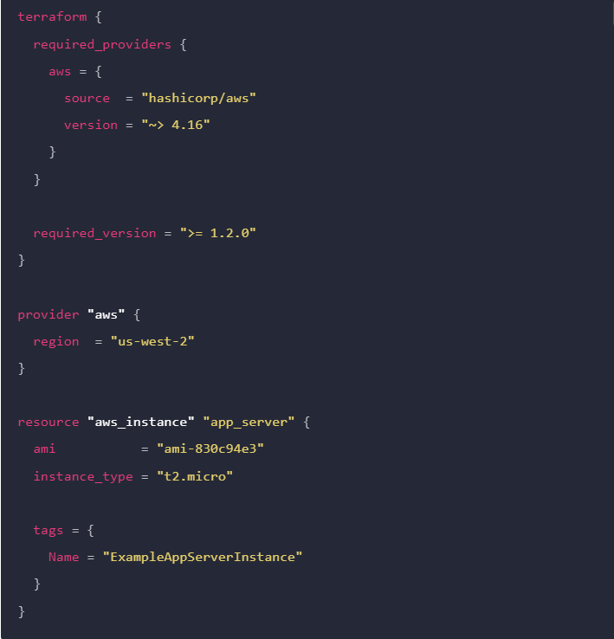
Terraform Configuration
Complete document that tells Terraform how to manage a given collection of infrastructure.
A configuration can consist of multiple files and directories.
Terraform Block terraform {} contains Terraform settings, including the required providers Terraform will use to provision your infrastructure.
Providers plugins called providers let Terraform interact with cloud platforms and other services via their application programming interfaces (APIs). Terraform Registry.
Resources defines the components of the infra

Slide 17
Exercise 3
Create Terraform configuration for single AWS EC2 instance
Terraform init
Terraform fmt
Terraform validate
Terraform apply

Slide 18
First lets create the directory for the config
Run the commands below
$ mkdir learn-terraform-aws
$ cd learn-terraform-aws
Create a file to define your infrastructure
$ touch main.tf
Copy the contents from notepad in Slack into your main.tf

Slide 19
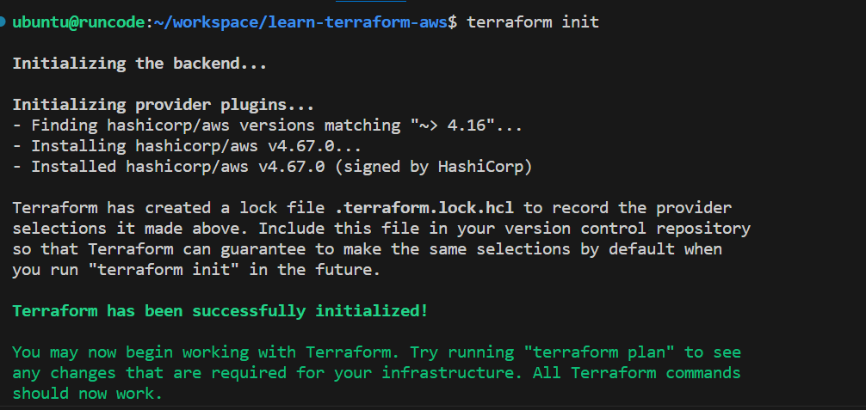
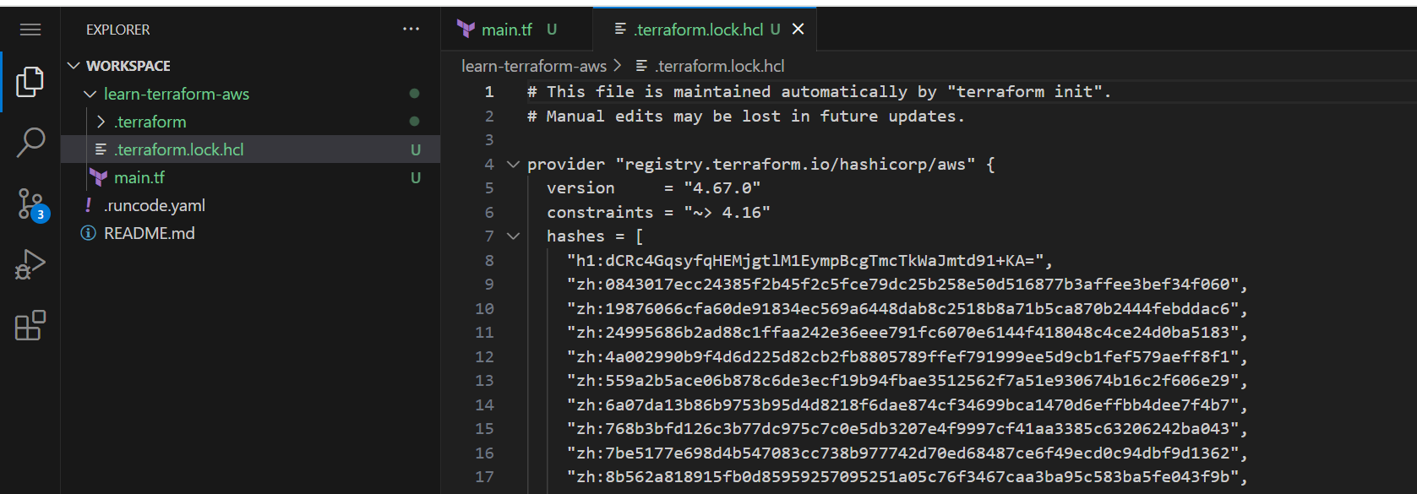
Terraform init
Run $ terraform init
Initializing a configuration directory downloads and installs the providers defined in the configuration, which in this case is the aws provider
Downloads provider and installs it in a hidden subdirectory of cwd - .terraform.
Prints the provider version which was installed.
Creates a lock file named .terraform.lock.hcl
.terraform.lock.hcl specifies the exact provider versions used, so that you can control when you want to update the providers used for your project.

Slide 20
Terraform fmt and validate
Automatically updates configurations in the current directory for readability and consistency.
$ terraform fmt
You can also make sure your configuration is syntactically valid and internally consistent by using the terraform validate command.
$ terraform validate

Slide 21
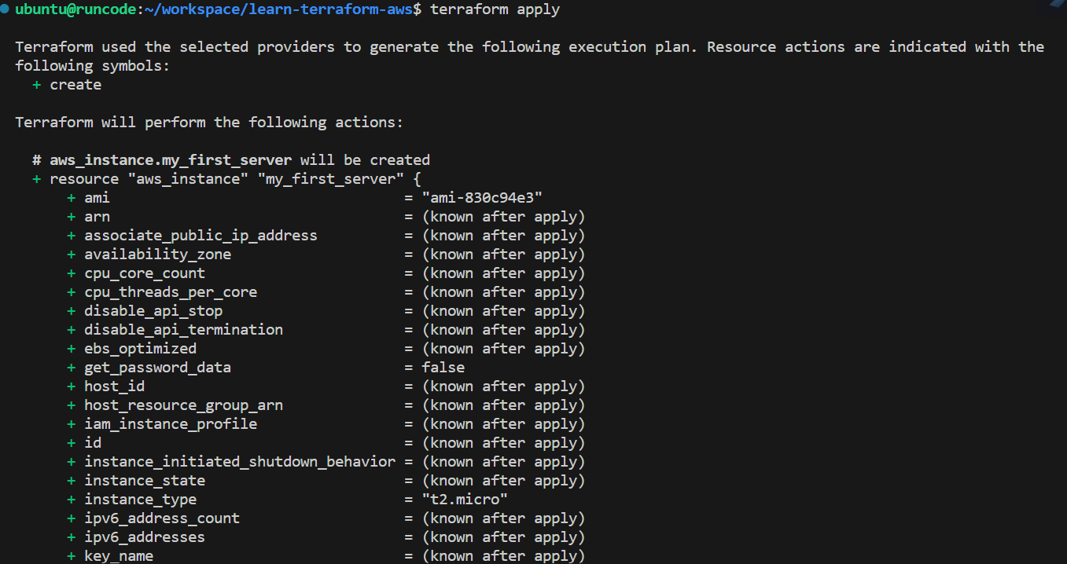
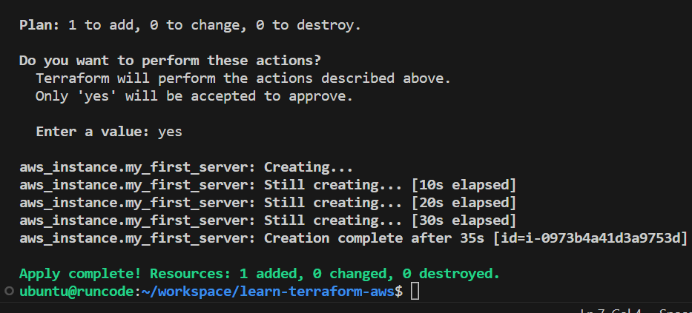
Terraform apply
Run $ terraform apply
Terraform prints out the execution plan
+ next to aws_instance.app_server, means resource will be created along with values
known after apply, it means that the value will not be known until the resource is created. eg. AWS assigns Amazon Resource Names (ARNs) to instances upon creation
Terraform waits for approval
Once approved it waits for the instance to be available

Slide 22
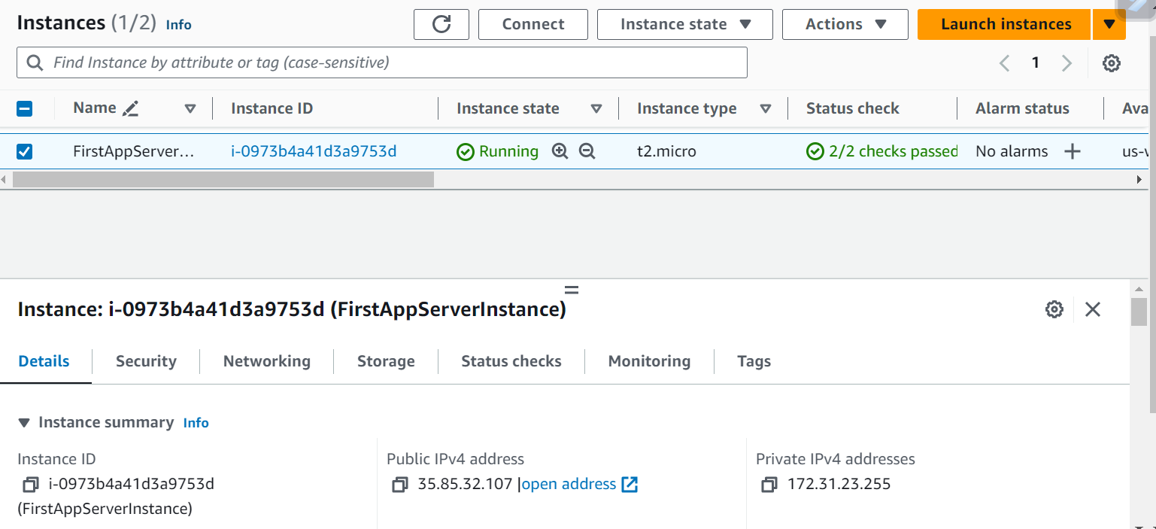
Validate and Celebrate!
Login to your AWS console
Check if you are in the right region which was mentioned in the main.tf
Launch the EC2 instance page

Slide 23
Exercise 4
Update the resource created
Destroy the resource
Terraform State

Slide 24
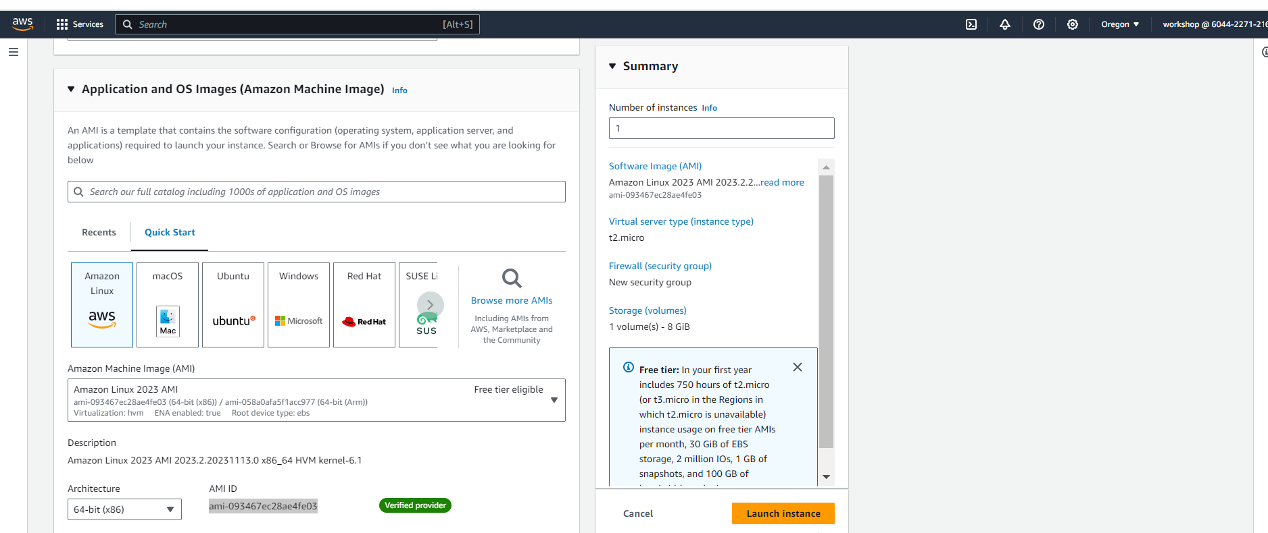
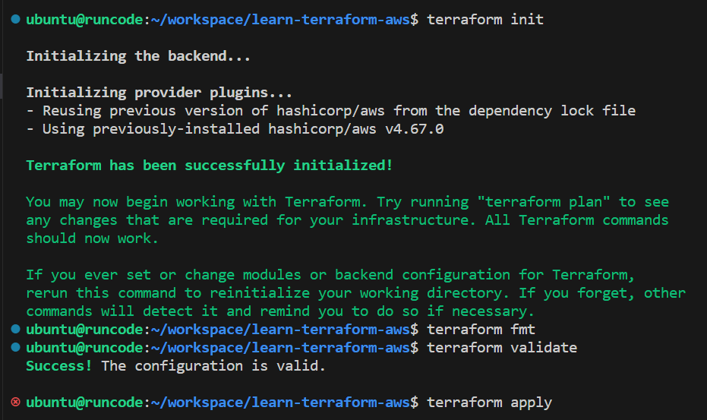
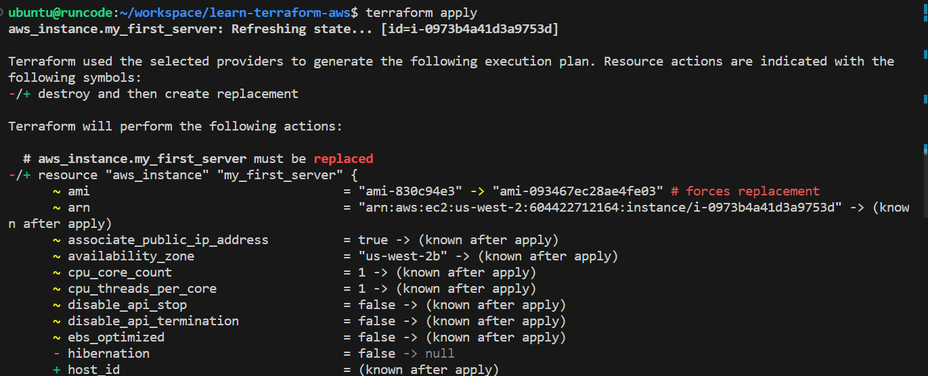
Update ec2 AMI
Get ami id from aws console
Now update the ami of your instance with ami from aws in the main.tf
Commands
$ terraform init
$ terraform fmt
$ terraform validate
$ terraform apply

Slide 25
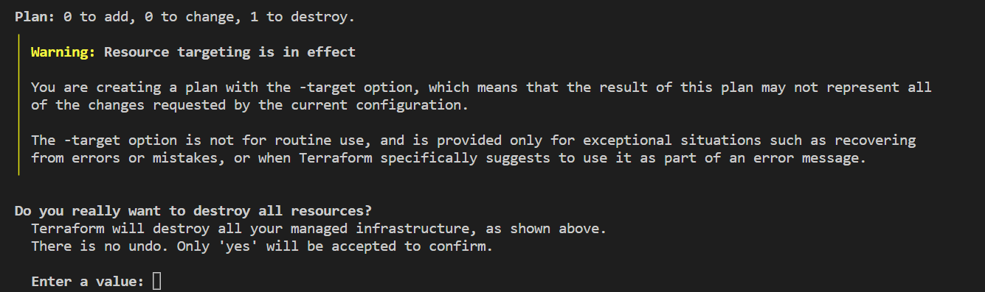
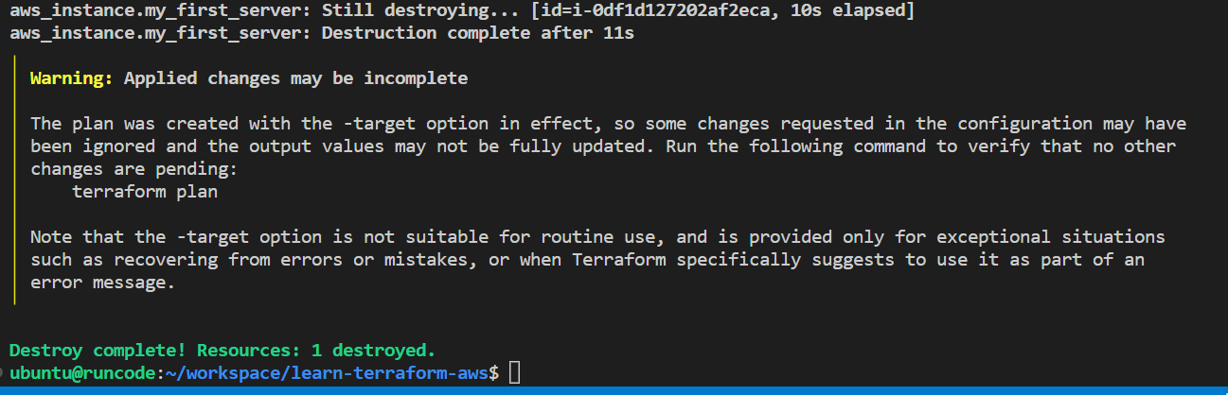
Terraform destroy
The terraform destroy command terminates all the resources specified in your Terraform state for that project
It does not destroy resources running elsewhere that are not managed by the current Terraform project
$ terraform destroy -target RESOURCE_TYPE.NAME

Slide 26
Terraform state
Terraform must store state about your managed infrastructure and configuration
$ terraform state
$ terraform state list
Feature | terraform.tfstate | terraform.tfstate.backup
Purpose | Current state file | Backup of the state file
When is it created? | Created automatically when you run terraform apply for the first time | Created automatically before Terraform makes any changes to the state file
When is it updated? | Updated every time you run terraform apply | Overwritten every time Terraform makes changes to the state file
Where is it stored? | Stored in the same directory as your Terraform configuration files | Stored in the same directory as the state file

Slide 27
What next
Install terraform
https://developer.hashicorp.com/terraform/install
Practice, some exercises for you to get started
Create multiple resources of same or different type
Delete only specific
Try the same for different providers like azure, gcp
Best Practices
AWS static keys not recommended ok for hobby but not best practice
Best to have your code on Git or any version control tool
Ensure you terminate your resources once done
Keep trying and making mistakes it’s the best way to learn
Feel free to reach out
www.linkedin.com/in/akshata-mongha

Slide 28
Thank you
WE INSPIRE WOMEN TO CODE

